Slide 1
Multi-class texture analysis in colorectal cancer histology

Slide 2
Dataset:
Dataset Description:
The dataset comprises histological images of colorectal tissue samples sourced from the research article titled "A novel representation of breast tissue histology for diagnosis" .The data (5000 samples ) was divided into two subsets: a training set, which encompasses 80% of the data (4000), and a test set, constituting the remaining 20% (1000).
Preprocessing Steps:
Loaded the dataset using the ‘tensorflow_datasets’ library, focusing on the training split.
Verified data dimensions with X.shape, indicating the number of samples, image height, width, and channels.
Flattened labels to simplify handling, resulting in ‘y_train.shape’ for training samples and ‘y_test.shape’ for test samples.
Transformed data type from uint8 to float32, and normalized pixel values to a range between 0.0 and 1.0.
Defined eight class names for labels, including categories like Tumour epithelium, Simple stroma, and Immune cells.
Nine experiments were performed on this dataset, involving various downsampling methods (32x32 pixels, PCA to 256-D, VGG-16) and classifiers (SVM, Softmax, Neural Network with 128-D dense layer).
Project Objective:
Develop a robust machine learning model for accurate colorectal tissue classification. Train on the dataset and evaluate on a separate test set for medical diagnostic and research applications.

Slide 3
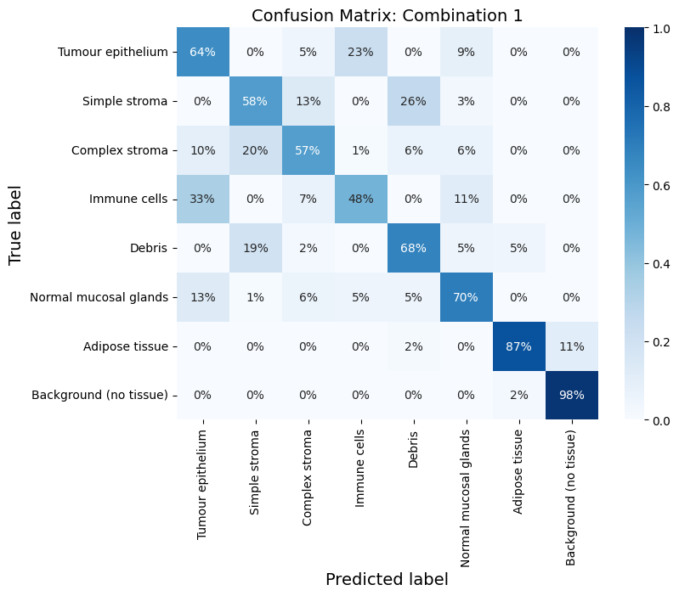
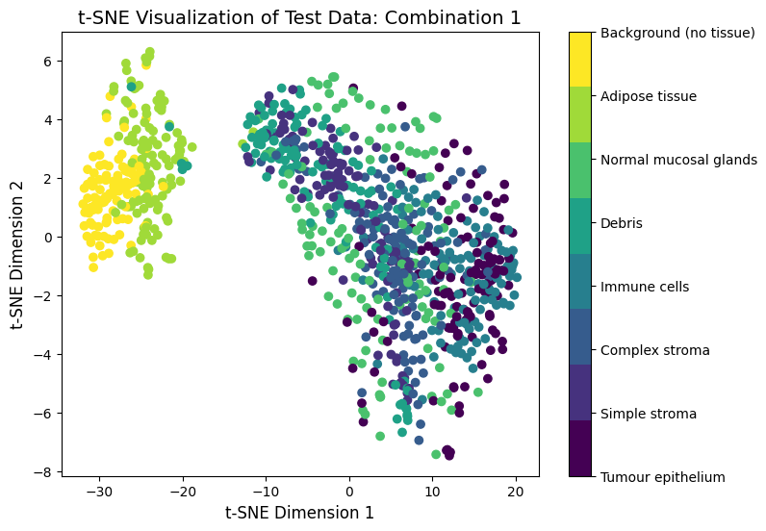
Combination 1: Downsampling to 32X32 + SVM
Training accuracy: 82.88%
Testing accuracy: 68.80%
Dimensionality reduction: downsampling images to 32x32 pixels and then flattening results in a 3072-D feature space.
Classifier: SVM classifier (C=0.01, kernel=linear).
We built a function for finding the best hyperparameter C from these values: 0.01, 0.1, 1, 10.

Slide 4
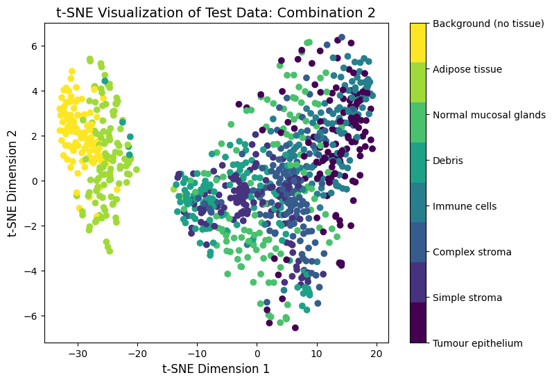
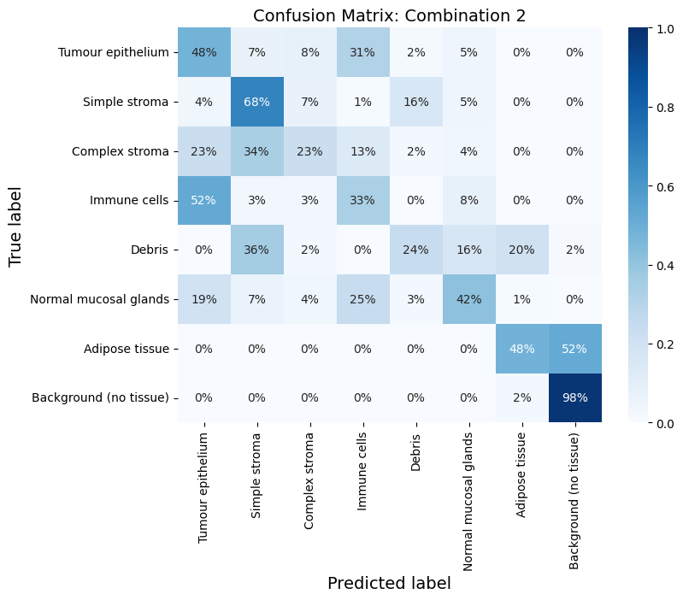
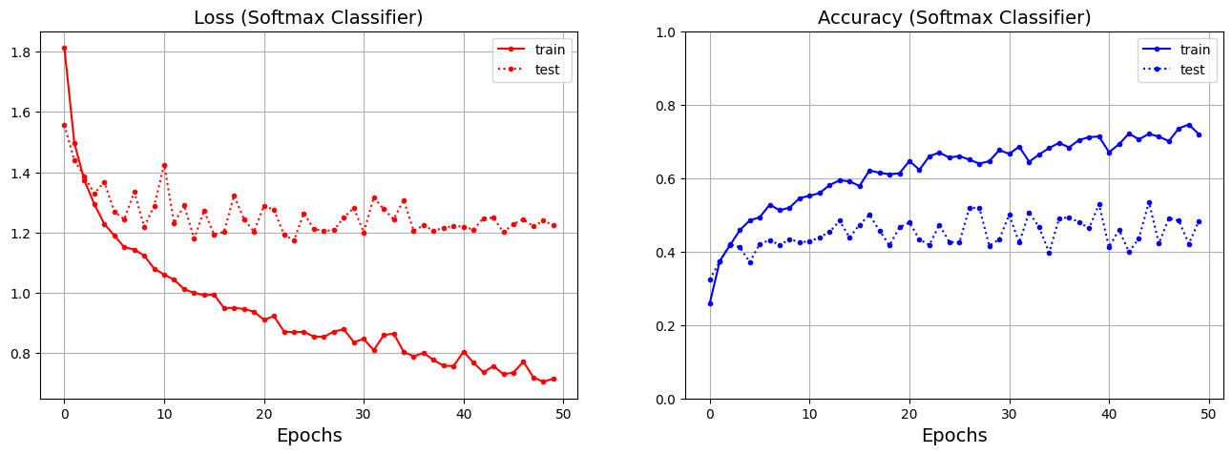
Combination 2: Downsampling to 32X32 + Softmax
Training accuracy: 79.98%
Testing accuracy: 48.30%
*Significant overfitting
Dimensionality reduction: downsampling images to 32x32 pixels and then flattening results in a 3072-D feature space.
Classifier: softmax classifier (optimizer= 'adam’, loss = 'categorical_crossentropy, metrics=['accuracy’], epochs=50,verbose=1, batch_size=64).

Slide 5
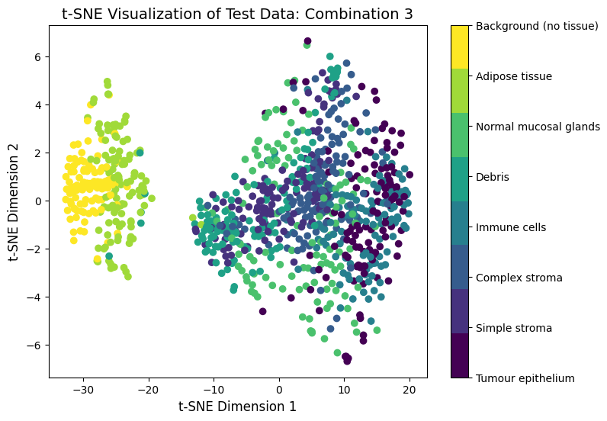
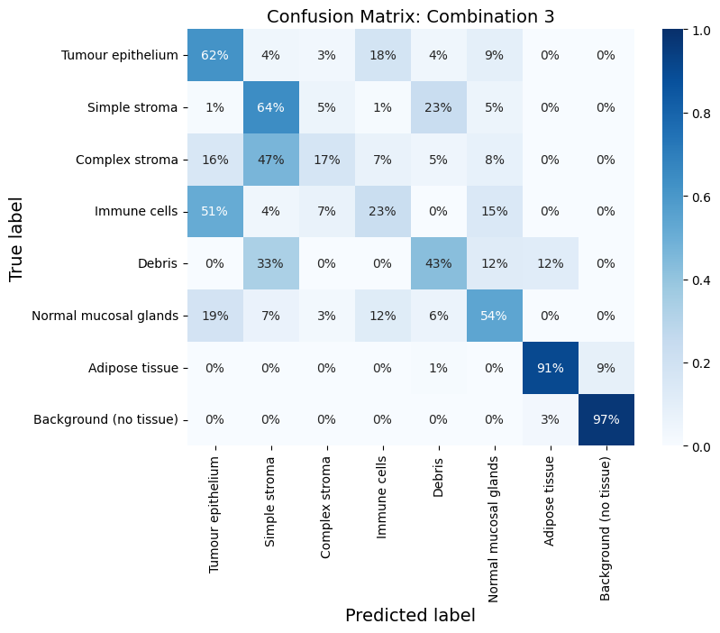
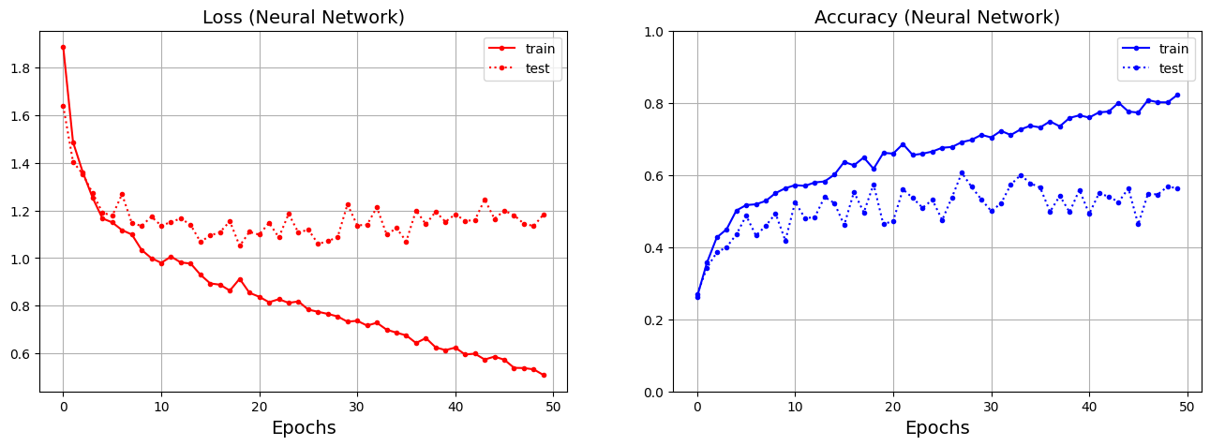
Combination 3: Downsampling to 32X32 + NN
Training accuracy: 83.38%
Testing accuracy: 56.30%
*Significant overfitting
Dimensionality reduction: downsampling images to 32x32 pixels and then flattening results in a 3072-D feature space.
Classifier: neural network classifier (activation=relu, activation=softmax, optimizer= 'adam’,
loss = 'categorical_crossentropy, metrics=['accuracy’], epochs=50,verbose=1, batch_size=64).

Slide 6
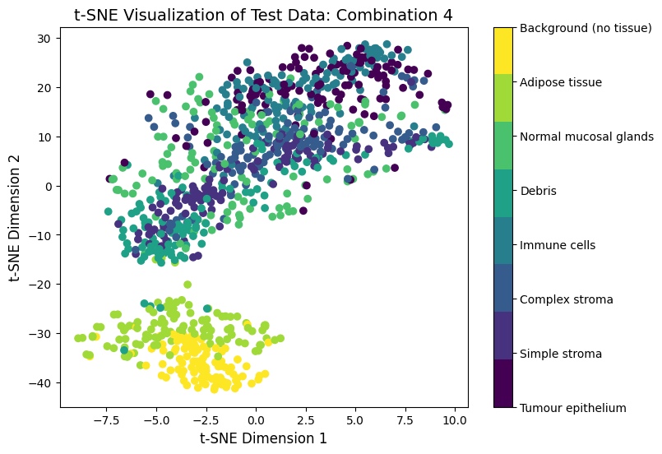
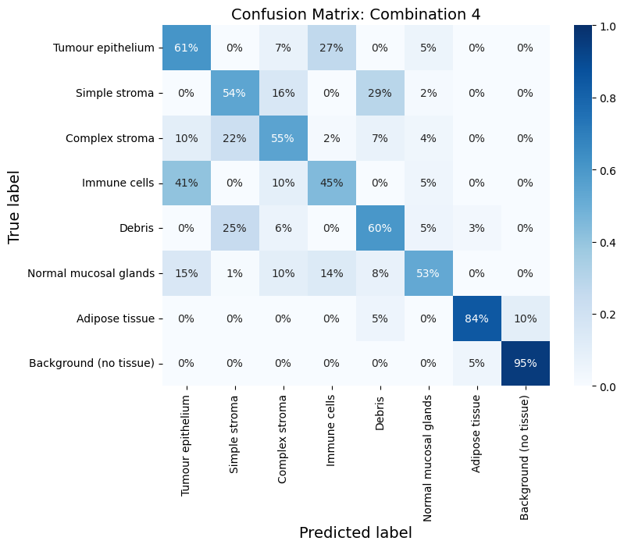
Combination 4: PCA + SVM
Training accuracy: 85.00%
Testing accuracy: 63.50%
Dimensionality reduction: applying PCA to reduce to 256 dimensions and then reshaping results in a 3072-D feature space.
Classifier: SVM classifier (C=0.01, kernel=linear).
We built a function for finding the best hyperparameter C from these values: 0.01, 0.1, 1, 10.

Slide 7
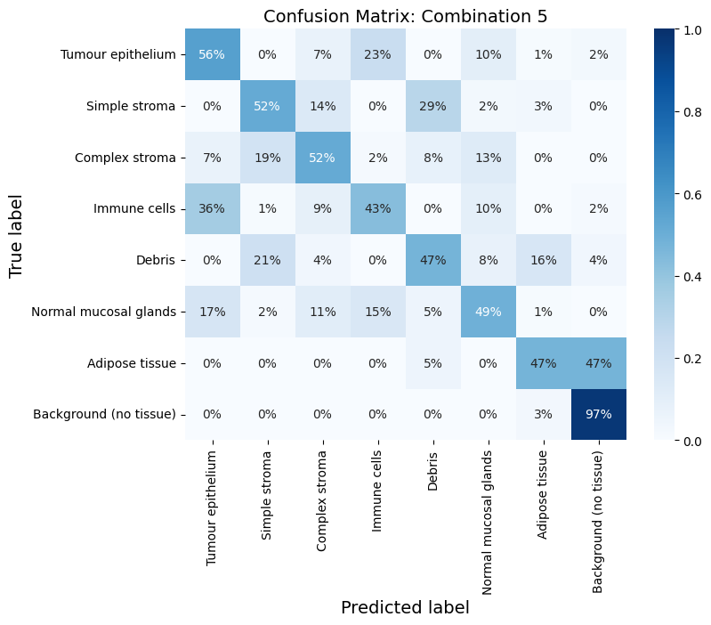
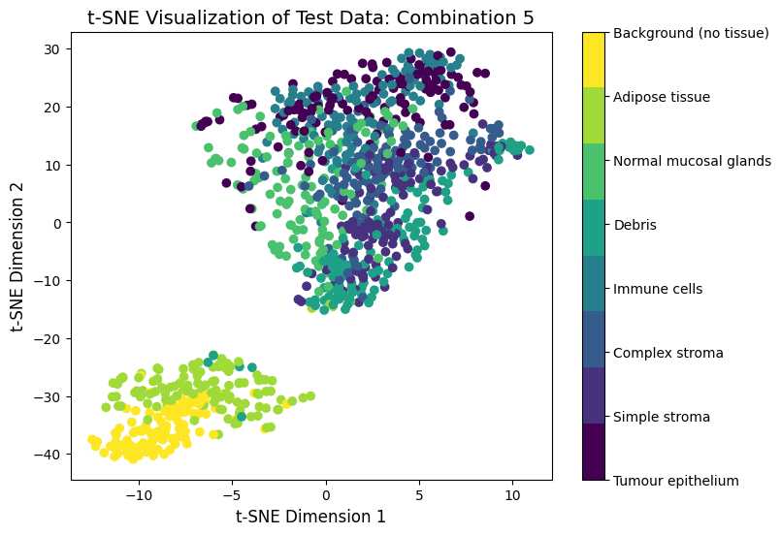
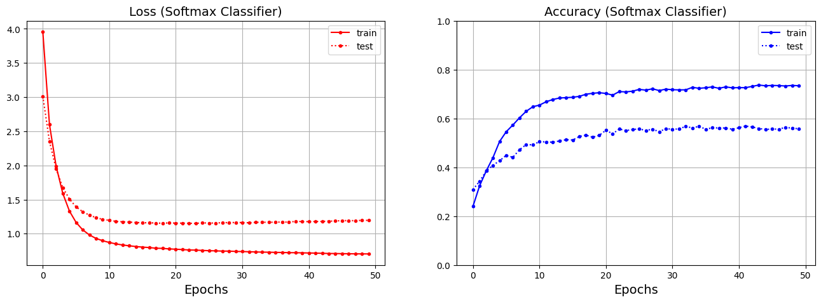
Combination 5: PCA + Softmax
Training accuracy: 76.17%
Testing accuracy: 55.81%
Dimensionality reduction: applying PCA to reduce to 256 dimensions and then reshaping results in a 3072-D feature space.
Classifier: softmax classifier (optimizer= 'adam’, loss = 'categorical_crossentropy, metrics=['accuracy’], epochs=50,verbose=1, batch_size=64).

Slide 8
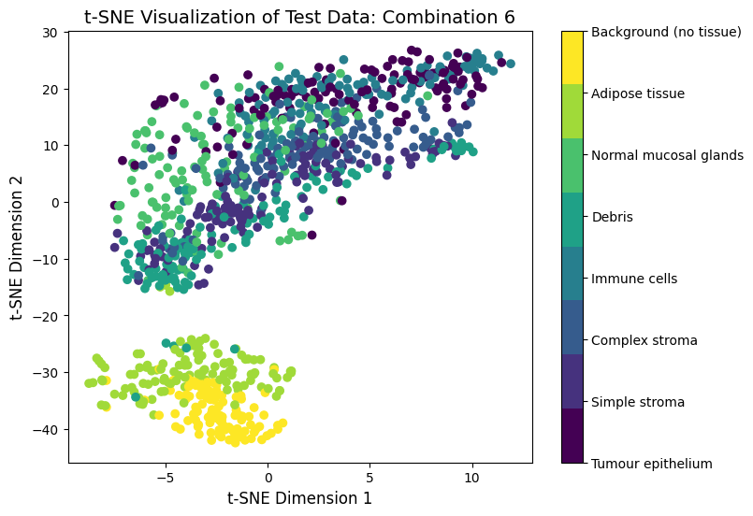
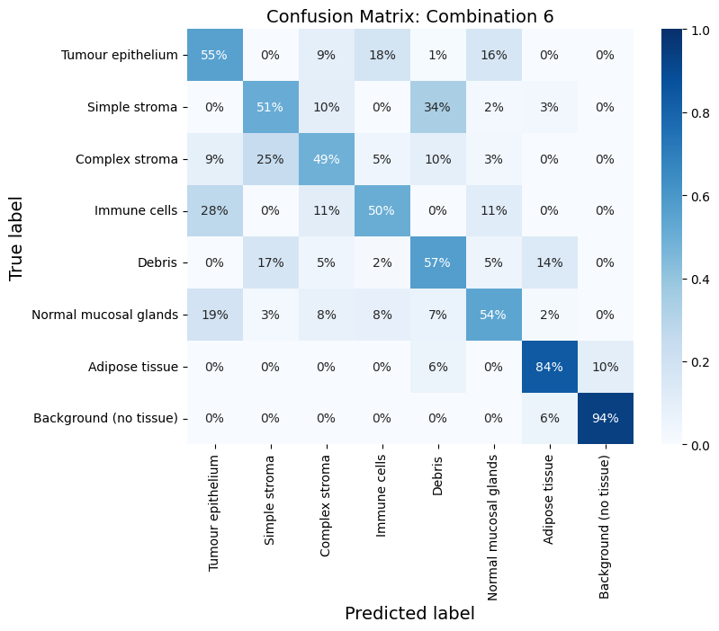
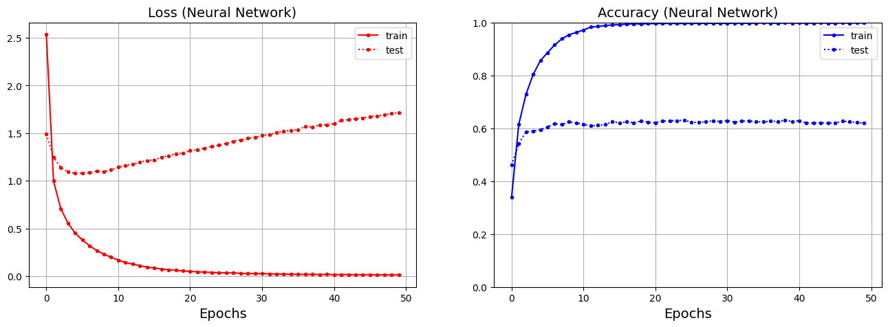
Combination 6: PCA + NN
Training accuracy: 99.83%
Testing accuracy: 61.90%
*Significant overfitting
Dimensionality reduction: applying PCA to reduce to 256 dimensions and then reshaping results in a 3072-D feature space.
Classifier: neural network classifier (activation=relu, activation=softmax, optimizer= 'adam’,
loss = 'categorical_crossentropy, metrics=['accuracy’], epochs=50,verbose=1, batch_size=64).

Slide 9
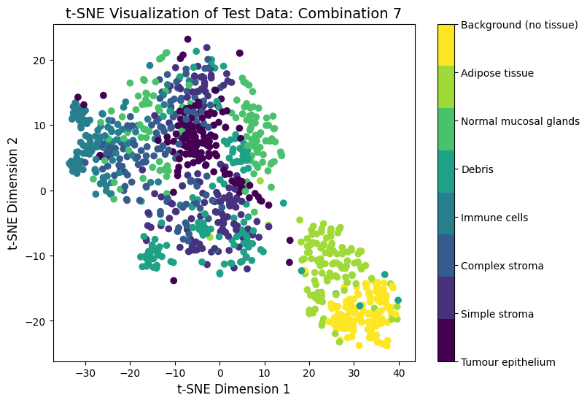
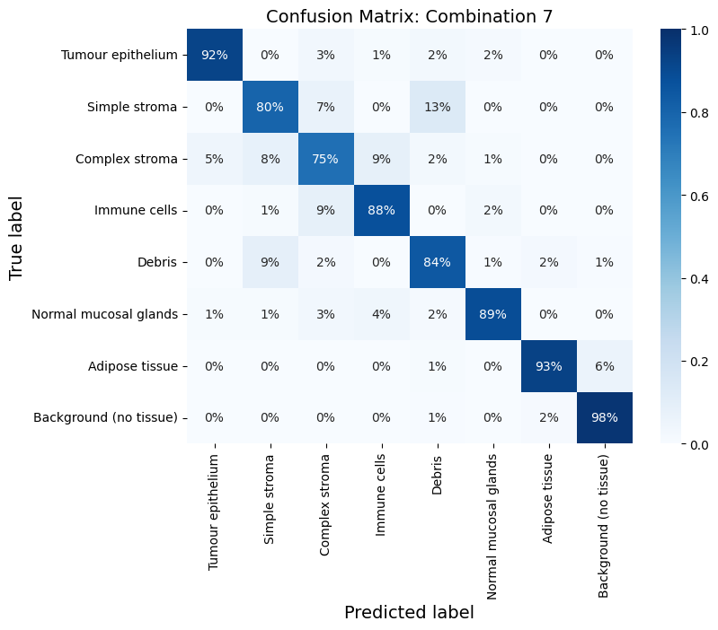
Combination 7: VGG16 + SVM
Training accuracy: 98.35%
Testing accuracy: 87.40%
Dimensionality reduction: applying VGG16 to 32x32 images and then flattening results in an 8192-D feature space.
Classifier: SVM classifier (C=0.01, kernel=linear).
We built a function for finding the best hyperparameter C from these values: 0.01, 0.1, 1, 10.

Slide 10
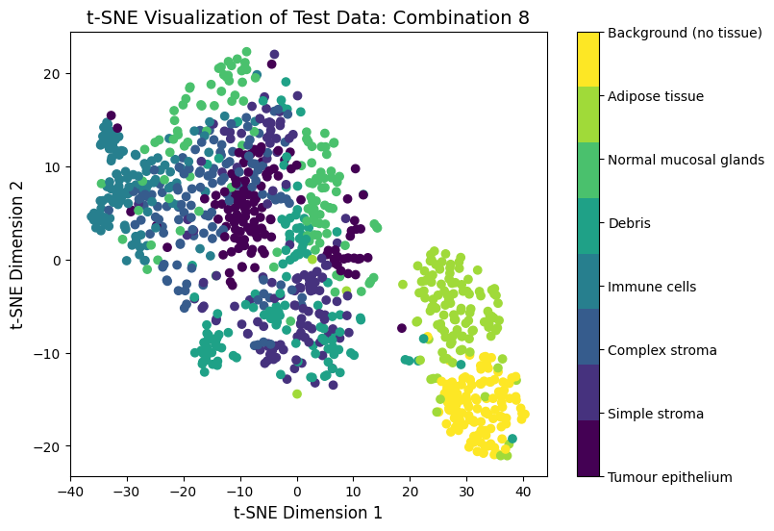

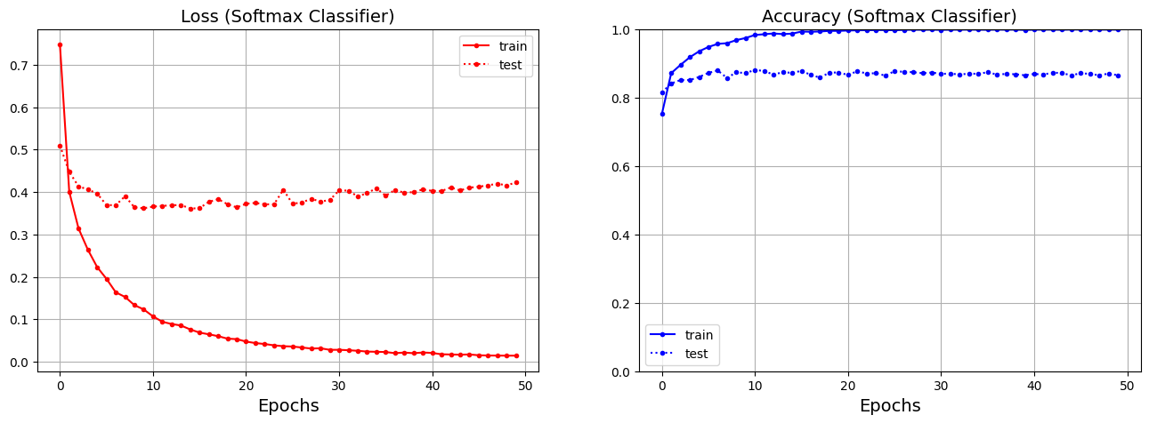
Combination 8: VGG16+ Softmax
Training accuracy: 99.85%
Testing accuracy: 86.50%
Dimensionality reduction: applying VGG16 to 32x32 images and then flattening results in an 8192-D feature space.
Classifier: softmax classifier (optimizer= 'adam’, loss = 'categorical_crossentropy, metrics=['accuracy’], epochs=50,verbose=1, batch_size=64).

Slide 11
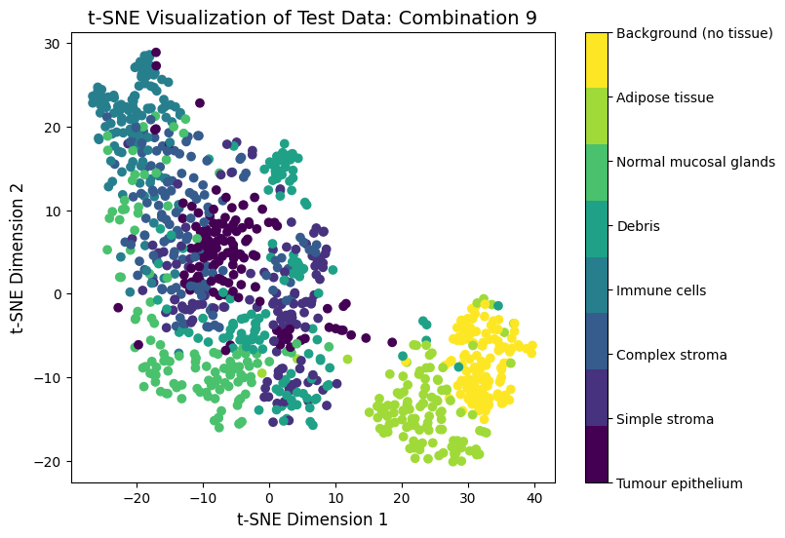

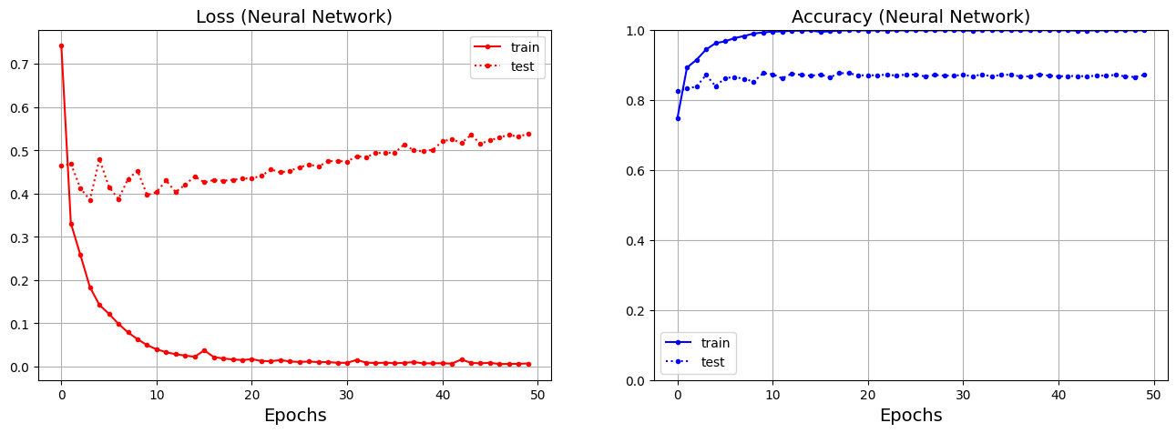
Combination 9: VGG16 + NN
Training accuracy: 99.90%
Testing accuracy: 87.10%
Dimensionality reduction: applying VGG16 to 32x32 images and then flattening results in an 8192-D feature space.
Classifier: neural network classifier (activation=relu, activation=softmax, optimizer= 'adam’,
loss = 'categorical_crossentropy, metrics=['accuracy’], epochs=50,verbose=1, batch_size=64).

Slide 12
Summary:
In our experiments, combination number 9, which involved dimensionality reduction using VGG16 + Neural Network model, demonstrated the best performance. It achieved a training accuracy of 99.90% and a testing accuracy of 87.10%, marking it as the most successful configuration in relation to the rest of combinations according to it’s both scores and the confusion matrix table results.
To further enhance the results in future work, we propose the following strategies:
1. Increase Training Data: Generating more training examples using data augmentation method. This involves techniques like rotation, scaling, and flipping the images in the train data, to provide the model with a more diverse set of samples.
2. Optimize Hyperparameters: Fine-tune settings like learning rates, batch sizes, and regularization terms to strike the right balance between accuracy and stability.
3. Explore Different Combinations: Trying various combinations of reduction methods and classifiers to find potentially more effective configurations tailored to the dataset.
4. Ensemble Learning: Combining multiple models to leverage their collective predictive power. This can lead to improved accuracy and robustness by aggregating the strengths of different models.
By implementing these strategies, we aim to elevate and improve the accuracy and reliability of our classification model.

Slide 13
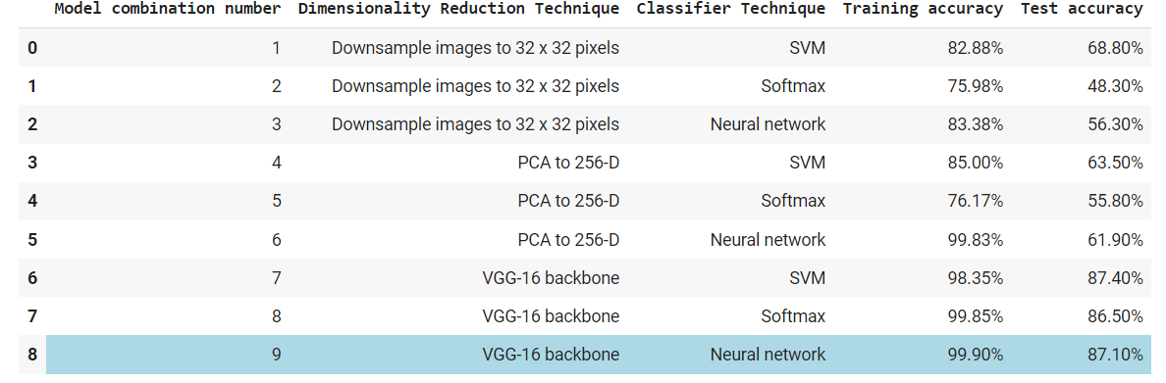
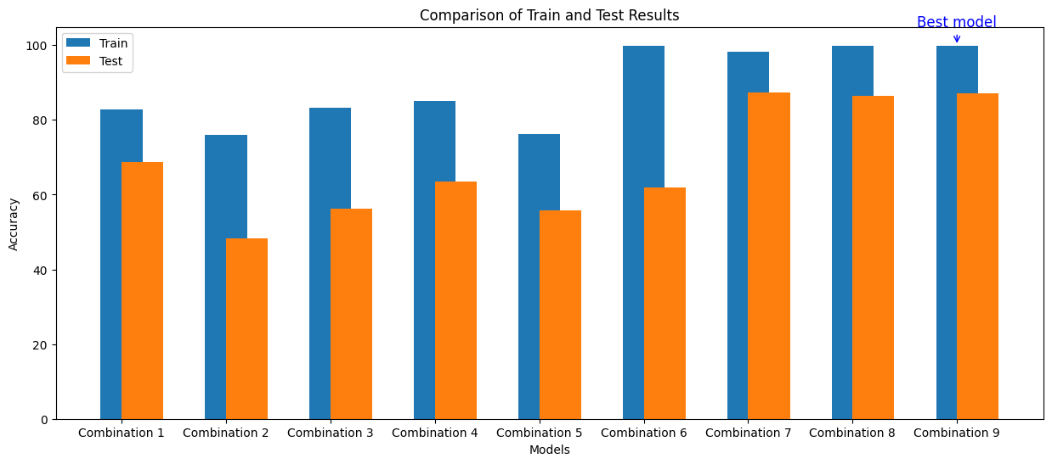
Summary:

Slide 14
The End!

